Slide 1
Distinguishable Photons (different arrival times)
Detector 1
Detector 2

Slide 2
Detector 1
Detector 2

Slide 3
Detector 1
Detector 2

Slide 4
Detector 1
Detector 2

Slide 5
Detector 1
Detector 2

Slide 6
Indistinguishable Photons (equal arrival times)
Detector 1
Detector 2

Slide 7
Detector 1
Detector 2

Slide 8
Detector 1
Detector 2

Slide 9
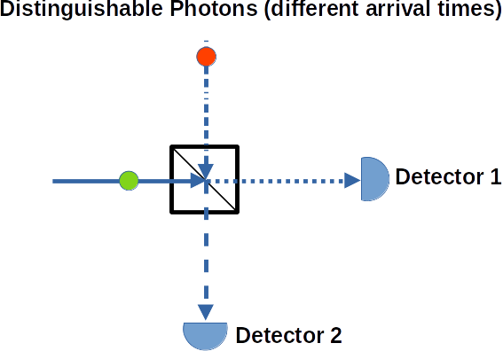
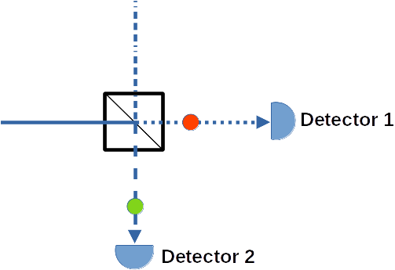
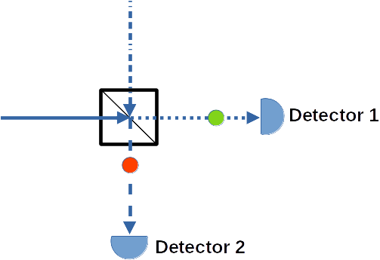
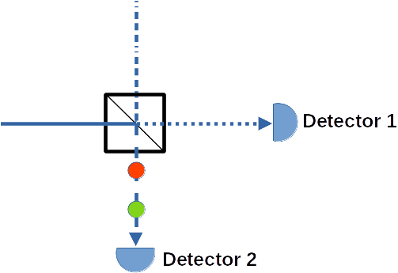
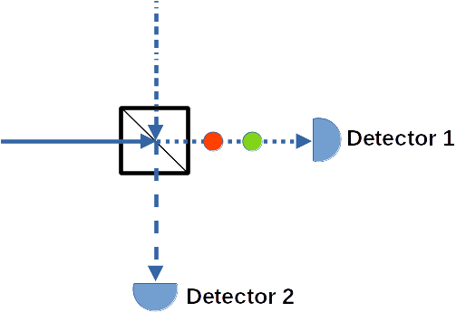

Slide 10
